Slide 1
CS 380
Introduction to Database Systems
(Chapter 5: Relational Database Design by ER- and EER-to-Relational Mapping)

Slide 2
Outline
ER-to-Relational Mapping Algorithm:
  Step 1: Mapping of Regular Entity Types
  Step 2: Mapping of Weak Entity Types
  Step 3: Mapping of Binary 1:1 Relationship Types
  Step 4: Mapping of Binary 1:N Relationship Types
  Step 5: Mapping of Binary M:N Relationship Types
  Step 6: Mapping of Mutivalued Attributes
  Step 7: Mapping of N-ary Relationship Types
Mapping EER Model Constructs to Relations:
  Step 8: Options for Mapping Specialization or Generalization
  Step 9: Mapping of Union Types (Categories)
Chapter 6: Relational Database Design by ER- and EER-to-Relational Mapping
1

Slide 3
Relational Database Design by ER- and EER-to-Relational Mapping
This corresponds to the logical database design (data model
mapping) step.
Chapter 6: Relational Database Design by ER- and EER-to-Relational Mapping
2

Slide 4
Step 1: Mapping of Regular Entity Types
For each regular (strong) entity type E in the ER schema, create a
relation R that includes all the simple attributes of E.
Choose one of the key attributes of E as the primary key for R.
If the chosen key of E is composite, the set of simple attributes that
form it will together form the primary key of R.
Chapter 6: Relational Database Design by ER- and EER-to-Relational Mapping
3

Slide 5
Step 1: Mapping of Regular Entity Types
CUSTOMER entity type with simple attributes:
CUSTOMER relation:
CUSTOMER
CustomerID
CustomerName
CustomerAddress
CUSTOMER
CustomerID
CustomerName
CustomerAddress
Chapter 6: Relational Database Design by ER- and EER-to-Relational Mapping
4

Slide 6
Step 1: Mapping of Regular Entity Types
CUSTOMER entity type with a composite attribute:
CUSTOMER relation with address detail:
CUSTOMER
Street
City
CustomerName
State
CustomerID
CUSTOMER
CustomerAddress
Zip
CustomerID
CustomerName
Street
City
State
Zip
Chapter 6: Relational Database Design by ER- and EER-to-Relational Mapping
5

Slide 7
Step 2: Mapping of Weak Entity Types
For each weak entity type W in the ER schema with owner entity
type E, create a relation R and include all simple attributes of W
as attributes of R.
Include as Foreign key attributes of R the primary key attribute(s) of
the relation(s) that correspond to the owner entity type(s).
The primary key of R is composed of:
    Partial key of the weak entity type W.
    Primary key(s) of the owner(s).
Chapter 6: Relational Database Design by ER- and EER-to-Relational Mapping
6

Slide 8
Step 2: Mapping Weak Entities to Relations
Weak entity DEPENDENT:
Relations:
EMPLOYEE
DEPENDENT
EmployeeID
EmployeeName
DependentName
DateOfBirth
1
HAS
N
EMPLOYEE
DEPENDENT
Gender
EmployeeID
EmployeeName
Foreign key
DependentName
EmployeeID
DateOfBirth
Gender
Composite primary key
Chapter 6: Relational Database Design by ER- and EER-to-Relational Mapping
7

Slide 9
Step 3: Mapping OF Binary 1:1 Relationship Types
For each binary 1:1 relationship type R in the ER schema, identify
relations S and T that correspond to the entity types participating in
R.
Chapter 6: Relational Database Design by ER- and EER-to-Relational Mapping
8

Slide 10
Step 3: Mapping OF Binary 1:1 Relationship Types
There are three possible approaches:
  Foreign key approach:
    Choose one of the relations - S, say - and include as a foreign
    key in S the primary key of T.
    It is better to choose an entity type with total participation in
    R in the role of S.
    Include all the simple attributes of the 1:1 relationship type R
    as attributes of S.
  Merged relation option:
    Merging the two entity types and the relationship into a
    single relation. (Used when both participations are total)
  Cross-reference or relationship relation option:
    Setting up a third relation R for the purpose of cross-
    referencing the primary keys of the two relations S and T
    representing the entity types.
Chapter 6: Relational Database Design by ER- and EER-to-Relational Mapping
9

Slide 11
Step 3: Mapping OF Binary 1:1 Relationship Types
one-to-one relationship:
Mapping the relationship (foreign key approach):
NURSE
CARE-CENTER
NurseID
NurseName
DateAssigned
CenterName
1
IN-CHARGE
1
Location
NURSE
CARE-CENTER
NurseID
NurseName
CenterName
Location
NurseInCharge
DateAssigned
Chapter 6: Relational Database Design by ER- and EER-to-Relational Mapping
10

Slide 12
Step 3: Mapping OF Binary 1:1 Relationship Types
one-to-one relationship:
Mapping the relationship (Merged relation option):
NURSE
NurseID
NurseName
DateAssigned
CenterName
1
IN-CHARGE
1
Location
NURSE
CARE-CENTER
NurseID
NurseName
CenterName
Location
DateAssigned
Chapter 6: Relational Database Design by ER- and EER-to-Relational Mapping
11

Slide 13
Step 3: Mapping OF Binary 1:1 Relationship Types
one-to-one relationship:
Mapping the relationship (Cross-reference option):
NURSE CARE-CENTER
NURSE-CARE-CENTER
NurseID
NurseName
DateAssigned
CenterName
1
IN-CHARGE
1
Location
NURSE
CARE-CENTER
NurseID
NurseName
CenterName
Location
NurseID
CenterName
DateAssigned
Chapter 6: Relational Database Design by ER- and EER-to-Relational Mapping
12

Slide 14
Step 4: Mapping of Binary 1:N Relationship Types
For each regular binary 1:N relationship type R, identify the relation
S that represents the participating entity type at the N-side of the
relationship type.
Include as foreign key in S the primary key of the relation T that
represents the other entity type participating in R.
Include any simple attribute of the 1:N relationship type as attributes
of S.
Chapter 6: Relational Database Design by ER- and EER-to-Relational Mapping
13

Slide 15
Step 4: Mapping of Binary 1:N Relationship Types
One-to-many relationship:
Mapping the relationship (foreign key approach):
CUSTOMER
ORDER
CustomerID
CustomerName
OrderID
OrderDate
1
SUBMIT
N
CUSTOMER
ORDER
CustomerID
CustomerName
OrderID
OrderDate
CustomerID
Chapter 6: Relational Database Design by ER- and EER-to-Relational Mapping
14

Slide 16
Step 4: Mapping of Binary 1:N Relationship Types
One-to-many relationship:
Mapping the relationship (Cross-reference option):
CUSTOMER ORDER
CUSTOMER-ORDER
CustomerID
CustomerName
OrderID
OrderDate
1
SUBMIT
N
CUSTOMER
ORDER
CustomerID
CustomerName
OrderID
OrderDate
CustomerID
OrderID
Chapter 6: Relational Database Design by ER- and EER-to-Relational Mapping
15

Slide 17
Step 5: Mapping of Binary M:N Relationship Types
For each binary M:N relationship type R, create a new relation S to
represent R.
Include as foreign key attributes in S the primary keys of the
relations that represent the participating entity types; their
combination will form the primary key of S.
Include any simple attributes of the M:N relationship type as
attributes of S.
Chapter 6: Relational Database Design by ER- and EER-to-Relational Mapping
16

Slide 18
Step 5: Mapping of Binary M:N Relationship Types
Many-to-many relationship:
Mapping the relationship:
RAW-MATERIAL VENDOR
SUPPLIED-BY
VendorID
MaterialID
UnitOFMeasure
UnitPrice
VendorName
M
SUPPLIIED-BY
N
VendorAddress
RAW-MATERIAL
VENDOR
MaterialID
UnitOFMeasure
VendorID
VendorName
VendorAddress
MaterialID
VendorID
UnitPrice
Chapter 6: Relational Database Design by ER- and EER-to-Relational Mapping
17

Slide 19
Step 6: Mapping of Multivalued Attributes
For each multivalued attribute A, create a new relation R. This
relation R will include an attribute corresponding to A, plus the
primary key attribute K - as a foreign key in R - of the relation that
represents the entity type or relationship type that has A as an
attribute.
The primary key of R is the combination of A and K.
If the multivalued attribute is composite, include its simple
components.
Chapter 6: Relational Database Design by ER- and EER-to-Relational Mapping
18

Slide 20
Step 6: Mapping of Multivalued Attributes
EMPLOYEE entity type with a multivalued attribute:
Multivalued attribute becomes a separate relation with a foreign key:
EMPLOYEE
EMPLOYEE_SKILL
EmployeeID
EmployeeName
EmployeeAddress
EMPLOYEE
Skill
EmployeeID
EmployeeName
EmployeeAddress
EmployeeID
Skill
Chapter 6: Relational Database Design by ER- and EER-to-Relational Mapping
19

Slide 21
Step 7: Mapping of N-ary Relationship Types
For each n-ary relationship type R, where n>2, create a new
relation S to represent R.
Include as foreign key attributes in S the primary keys of the
relations that represent the participating entity types.
Include any simple attributes of the n-ary relationship type as
attributes of S.
Chapter 6: Relational Database Design by ER- and EER-to-Relational Mapping
20

Slide 22
Step 7: Mapping of N-ary Relationship Types
Ternary relationship type:
Mapping the n-ary relationship type SUPPLY:
SUPPLIER PROJECT PART
SUPPLY
PartNo
SName
PART
PName
SUPPLIER
SUPPLY
PROJECT
Quantity
SName
PName
PartNo
SName
PName
PartNo
Quantity
Chapter 6: Relational Database Design by ER- and EER-to-Relational Mapping
21

Slide 23
Correspondence Between ER and Relational Models
ER Model Relational Model
Entity type “Entity” relation
1:1 or 1:N relationship type Foreign key (or “relationship” relation)
M:N relationship type “Relationship” relation and two foreign keys
n-ary relationship type “Relationship” relation and n foreign keys
Simple attribute Attribute
Composite attribute Set of simple component attributes
Mutivalued attribute Relation and foreign key
Value set Domain
Key attribute Primary (or secondary) key
Chapter 6: Relational Database Design by ER- and EER-to-Relational Mapping
22

Slide 24

Example
Chapter 6: Relational Database Design by ER- and EER-to-Relational Mapping
23

Slide 25

Example
Chapter 6: Relational Database Design by ER- and EER-to-Relational Mapping
24

Slide 26
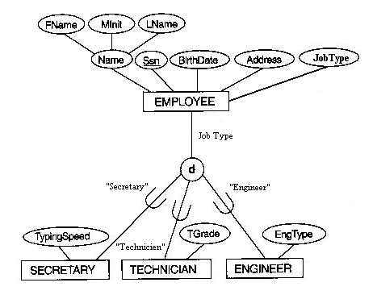
Step 8: Options for Mapping Specialization or Generalization
Option 8A: Multiple Relations - Superclass and Subclasses
This option works for any
specialization.
SECRETARY
TECHNICIAN
ENGINEER
EMPLOYEE
SSN
TypingSpeed
SSN
TGrade
SSN
EngType
SSN
FName
Minit
LName
BirthDate
Address
JobType
Chapter 6: Relational Database Design by ER- and EER-to-Relational Mapping
25

Slide 27
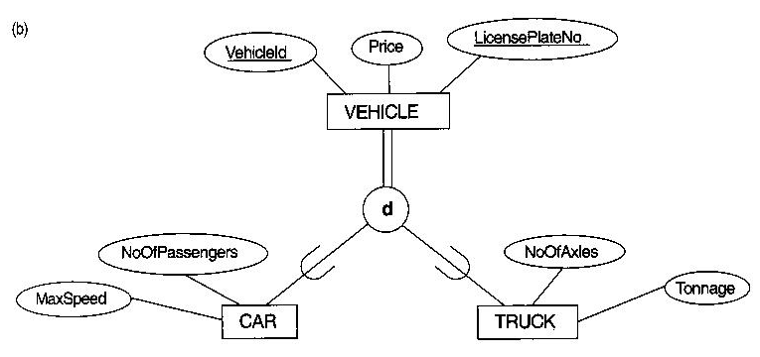
Step 8: Options for Mapping Specialization or Generalization
Option 8B: Multiple Relations - Subclass Relations Only
This option only
works for a
specialization whose
subclasses are total.
CAR
TRUCK
VehicleID
LicensePlateNo
Price
MaxSpeed
NoOfPassengers
VehicleID
LicensePlateNo
Price
NoOfAxies
Tonnage
Chapter 6: Relational Database Design by ER- and EER-to-Relational Mapping
26

Slide 28
Step 8: Options for Mapping Specialization or Generalization
Option 8C: Single Relation With One Type Attribute
This option:
Works only for a
specialization whose
subclasses are disjoint.
Has the potential for
generating many null
values if many specific
attributes exist in the
subclasses.
EMPLOYEE
SSN
FName
Minit
LName
BirthDate
Address
JobType
TypingSpeed
TGrade
EngType
Chapter 6: Relational Database Design by ER- and EER-to-Relational Mapping
27

Slide 29
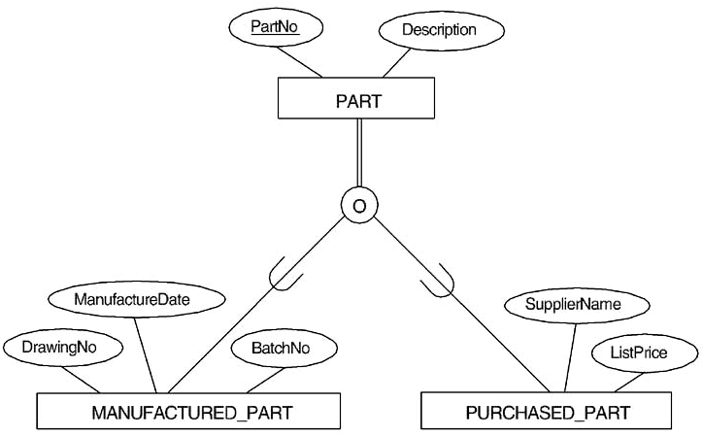
Step 8: Options for Mapping Specialization or Generalization
Option 8D: Single Relation With Multiple Type Attributes
This option works for
a specialization whose
subclasses are
overlapping
(It also works for a
disjoint
specialization).
PART
PartNo
Description
MFlag
DrawingNo
ManufactureDate
BatchNo
PFlag
SupplierName
ListPrice
Chapter 6: Relational Database Design by ER- and EER-to-Relational Mapping
28

Slide 30
Step 8: Options for Mapping Specialization or Generalization
Mapping of Shared Subclasses (Multiple Inheritance)
Shared subclasses must have the same key attribute; otherwise the
shared subclass would be modeled as a category.
Any of the options discussed in step 8 can be applied to a shared
subclass.
Chapter 6: Relational Database Design by ER- and EER-to-Relational Mapping
29

Slide 31
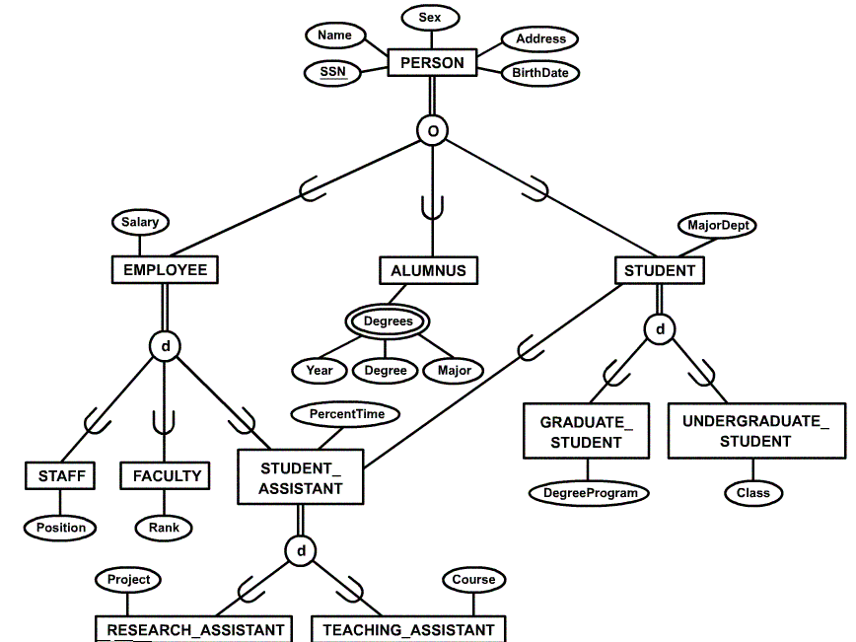
Step 8: Options for Mapping Specialization or Generalization
Mapping of Shared Subclasses (Multiple Inheritance)
Chapter 6: Relational Database Design by ER- and EER-to-Relational Mapping
30

Slide 32
Step 8: Options for Mapping Specialization or Generalization
Mapping of Shared Subclasses (Multiple Inheritance)
PERSON
EMPLOYEE
STUDENT
ALUMNUS ALUMNUS-DEGREE
SSN
Name
BirthDate
Sex
Address
SSN
Salary
EmployeeType
Position
Rank
PercentTime
RAFlag
TAFlag
Project
Course
SSN
MajorDept
GradFlag
UndergradFlag
DegreeProgram
Class
StudAssistFlag
SSN
SSN
Year
Degree
Major
Chapter 6: Relational Database Design by ER- and EER-to-Relational Mapping
31

Slide 33
Step 9: Mapping of Union Types (Categories)
For mapping a category whose defining subclasses have different
keys, it is customary to specify a new key attribute, called a
surrogate key, when creating a relation to correspond to the
category.
Chapter 6: Relational Database Design by ER- and EER-to-Relational Mapping
32

Slide 34
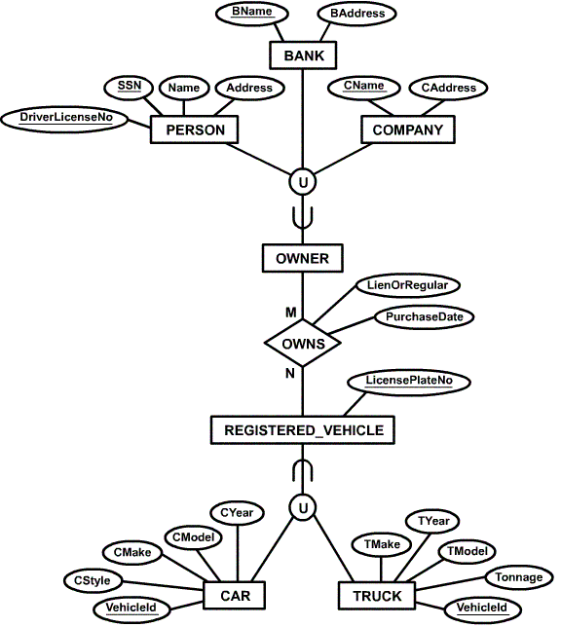
Step 9: Mapping of Union Types (Categories)
Chapter 6: Relational Database Design by ER- and EER-to-Relational Mapping
33

Slide 35
Step 9: Mapping of Union Types (Categories)
PERSON
BANK COMPANY
OWNER REGESTERED-VEHCLE
CAR TRUCK
OWNS
SSN
DriverLicenseNo
Name
Address
OwnerID
BName
BAddress
OwnerID
CName
CAddress
OwnerID
OwnerID
VehicleID
LicensePlateNumber
VehicleID
CStyle
CMake
CModel
CYear
VehicleID
TStyle
TMake
Tonnage
TYear
OwnerID
VehicleID
PurchaseDate
LienOrRegular
Chapter 6: Relational Database Design by ER- and EER-to-Relational Mapping
34

Slide 36
Hand Outs

Slide 37


Slide 39
Step 8: Options for Mapping Specialization or Generalization
Mapping of Shared Subclasses (Multiple Inheritance)
Chapter 6: Relational Database Design by ER- and EER-to-Relational Mapping
30

Slide 40
Step 9: Mapping of Union Types (Categories)
Chapter 6: Relational Database Design by ER- and EER-to-Relational Mapping
33

